Slide 1
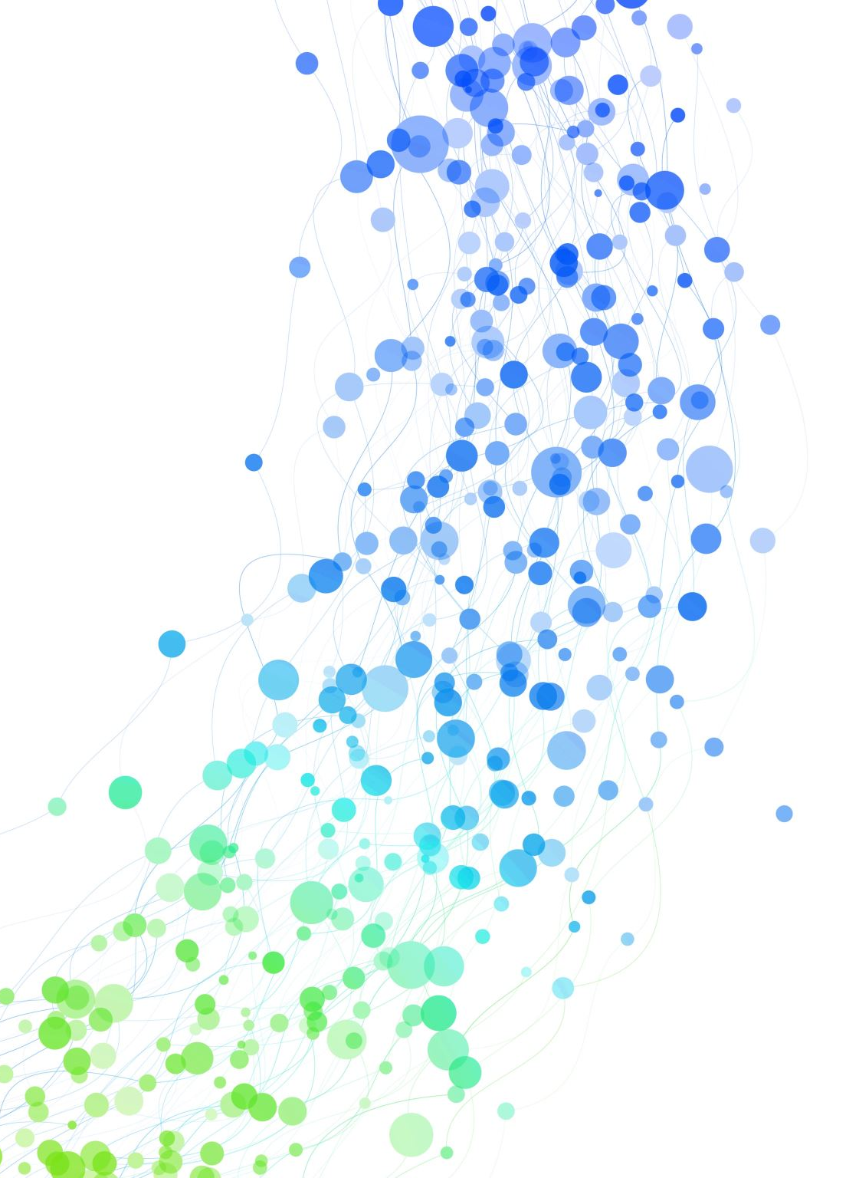

Firm Bankruptcy Prediction: An Ensemble Approach
MGMT 571 – Data Mining Project Presentation

Slide 2



Team Introduction
Subtitle
Ashvin Raj
Samridhi Vats
Nagraj Deshmukh

Slide 3

Problem Statement
Context
Predicting Firm Bankruptcy using Classification Algorithms : A Century-Old Economic Challenge
Importance
Goal
Crucial for Investors, Policymakers, and Business Leaders
Developing a Robust Predictive Model to Foresee Financial Distress

Slide 4
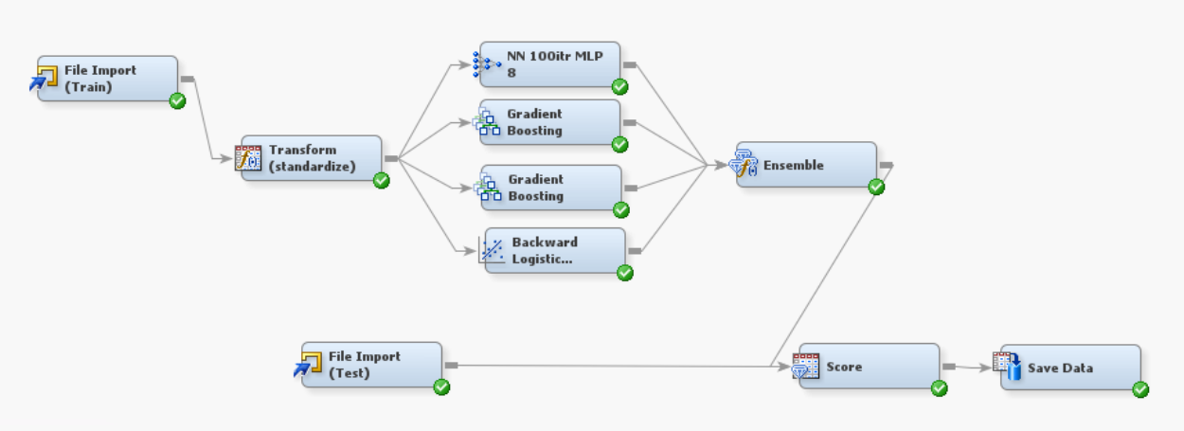
Our Best Solution: An Ensemble Model Utilizing Neural Networks, Gradient Boosting, and Logistic Regression

Slide 5
Achieves a balance between sensitivity (identifying true positives) and specificity (reducing false positives)
Ensures robustness against overfitting and underfitting
Adjustments made based on performance metrics and feedback loops
Data Pre-processing
Model Selection
Ensemble Model
Testing & Score Prediction
Standardized the variables using Transform node
Partitioned the Data while model training, however used the entire training data for final prediction
Neural Network
Gradient Boosting
Backward LR
Feature: Deep Learning for High-Dimensional Data Analysis
Benefit: Exceptional at Identifying Non-linear Relationships in Financial Indicators
Application: Analyzing complex patterns across vast datasets for subtle distress signals
Feature: Sequential Improvement for Enhanced Predictions
Benefit: Reduces bias and variance, leading to more accurate results
Application: Aggregating weak predictive models to strengthen overall performance
Feature: Refined Variable Selection for Predictive Relevance
Benefit: Eliminates redundant variables, focusing on the most impactful predictors
Application: Streamlining model for efficiency, retaining only significant financial indicators

Slide 6
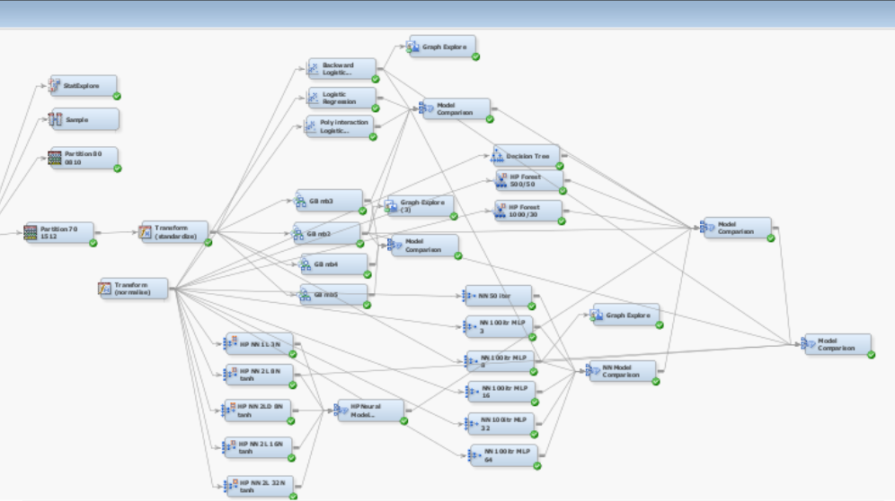
Trials

Slide 7

Trials
Subtitle
Gradient Boosting
Neural Network
HP - Neural
Backward Logistic
Polynomial Regression
reuse, N iterations, shrinkage, Train Proportion, maximum branch, maximum depth.
Different number of nodes: 8, 16, 32, 64. Number of iterations: 50, 100
2 layers (8, 16)
Selection Criteria – Cross Validation Misclassification
Polynomial Degree = 2

Slide 8

When to use Data Partition ?
During the model selection stage, we use data partition to create a validation set for comparing different models
Once we select a model, we can then use the whole training data to train our model

Slide 9
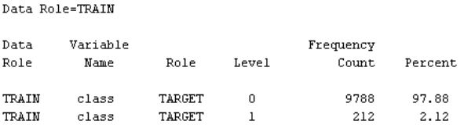

Data processing
Filtering outliers in features :
Many features had outliers, but we decided not to filter them as they might be relevant for predicting the minority class.
Imbalanced train data Vs balanced test data

Slide 10
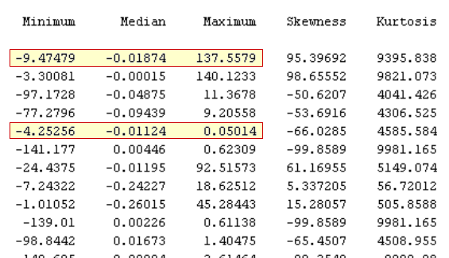
Data processing
How standardization helps :
Neural Network :
With unscaled features, learning process tends to be slow, as the learning rate may need to be adjusted for each feature
Prevents exploding or vanishing gradients and helps make the Neural Network more stable
Linear regression :
LR is sensitive to the scale of input features

Slide 11
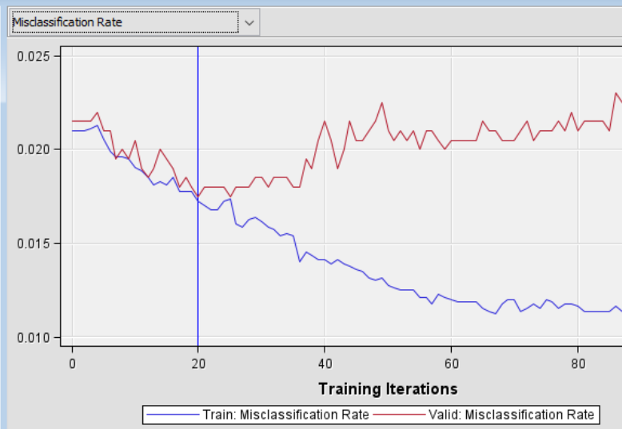
Moving towards Ensemble
After a point, we could see that the model was overfitting, and a lower misclassification rate could not be achieved by a single model

Slide 12
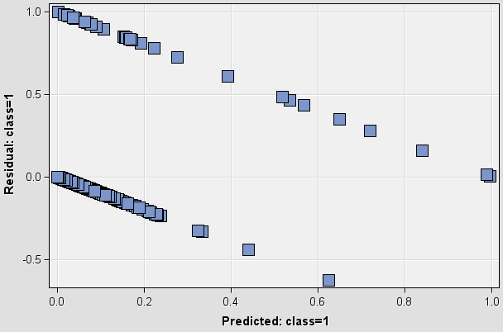
Insights
- Residual plots only help in linear models and are not useful for non-linear models
- It’s better to look at ROC curve or precision-recall curve

Slide 13
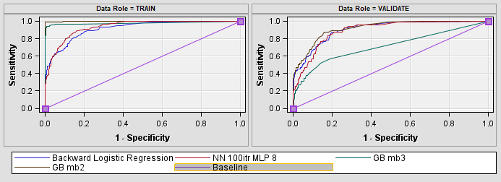
Insights
Why ensemble performs better:
If the different models in the ensemble can cover different solution spaces, then the ensemble can outperform the individual component models.
Data Synergy: Harmonizes different data types and outputs for unified analysis
Effective across various firm sizes and adaptable to economic changes.
Combines sensitivity and specificity to reduce error rates.

Slide 14

Challenges
Limit to the increase in ROC when trying individual models
Difficulty in oversampling the minority class or to use methods like SMOTE in SAS EM

Slide 15

Thank you

